Slide 1
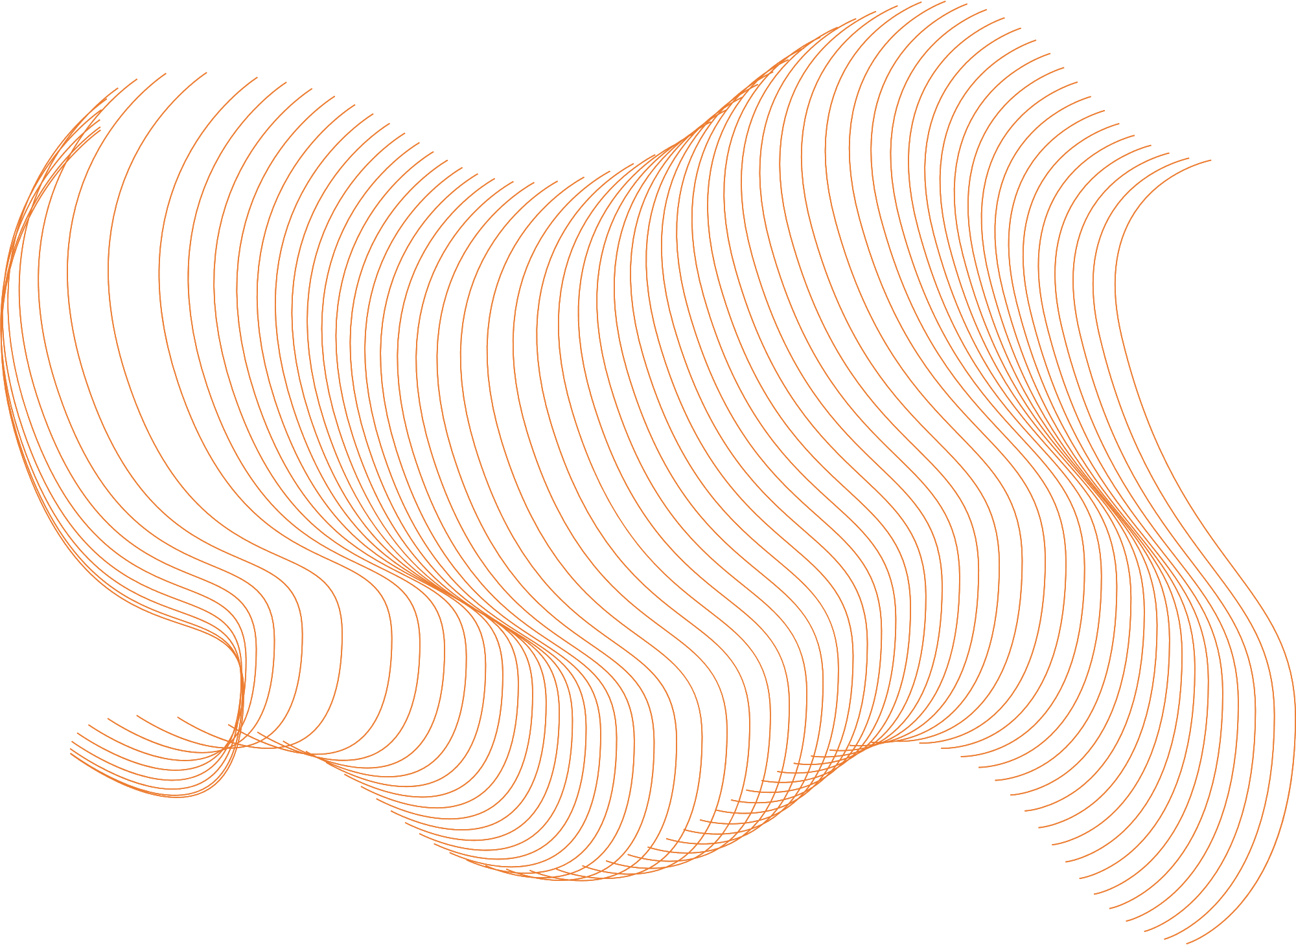

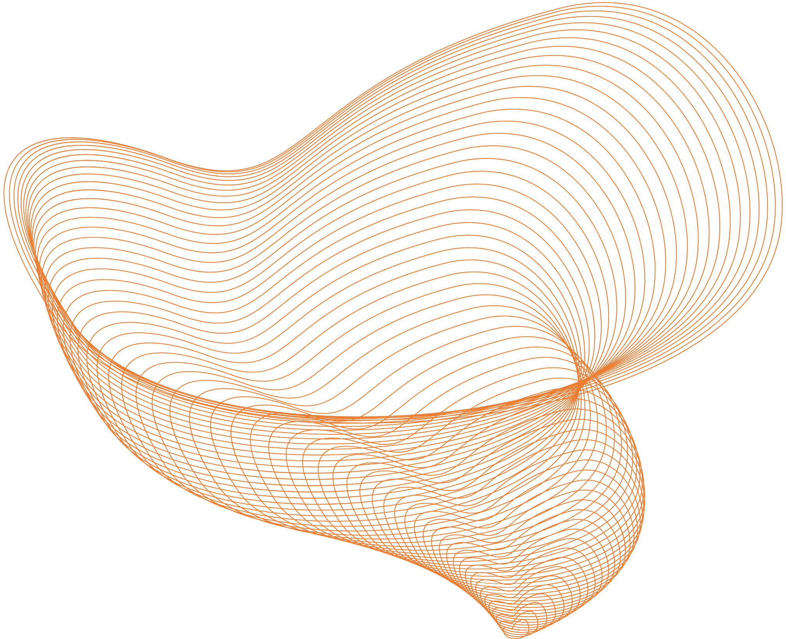

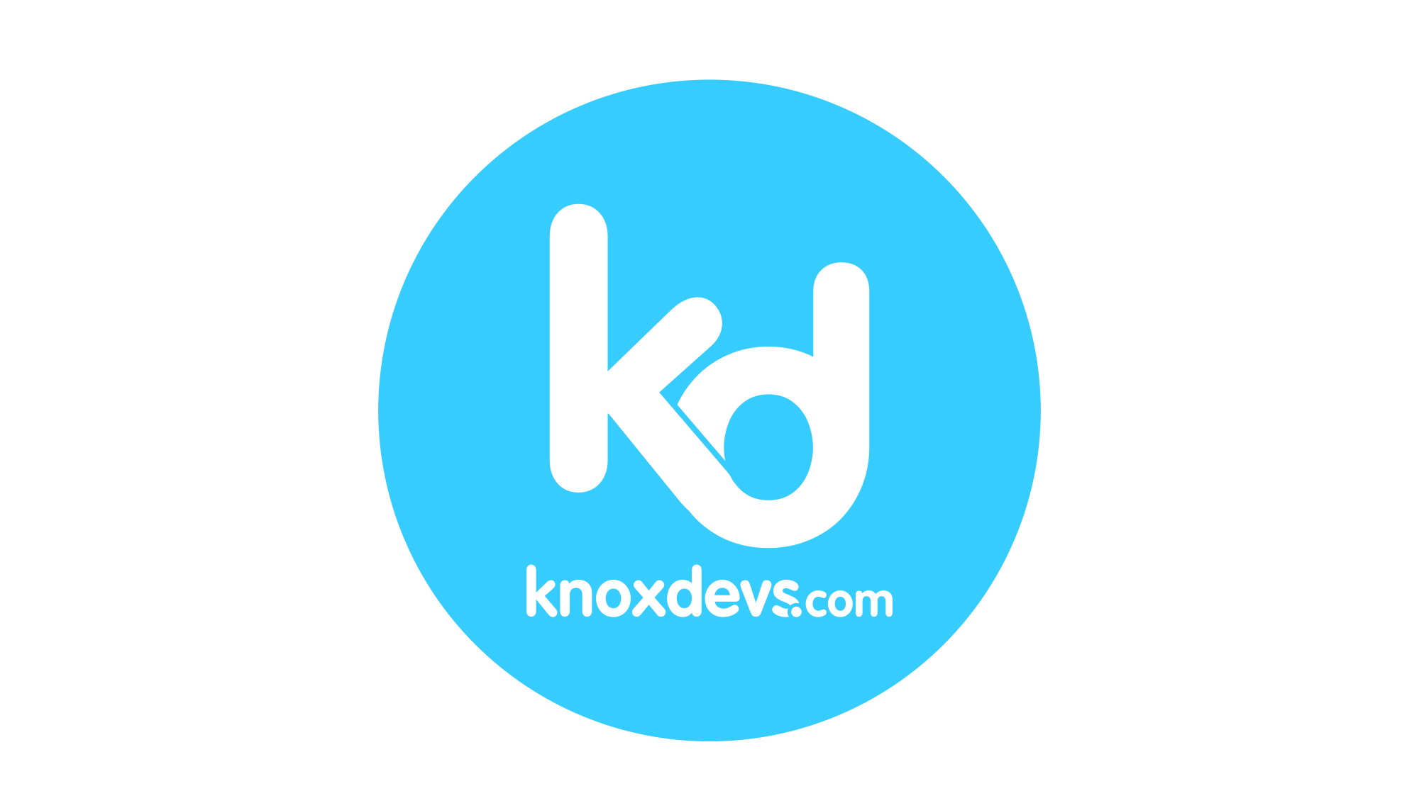

A Leading Edge Technical Conference

Slide 2











Sponsors

Slide 3


It’s A Me, MarI/O
A Beginner's Experience With Machine Learning and Super Mario
Houston Miller
@HueyTheDM
Linkedin.com/in/houston-miller

Slide 4
What isn’t this talk? What is it?
Not a technical deep dive
Don’t worry, there is code!
Not explaining the nuances of different learning algorithms
My successes
My failures
Basic overview of the process of Reinforcement Learning
My journey

Slide 5
Trigger Warning
Depression
Pandemic

Slide 6
About me
Graduated from Maryville College, BA in Computer Science
Software Developer since 2011
C#, .NET, Typescript
Notes:
Mention thesis? Beginnings of interest in AI/ML mutations (self altering codebase) and learning

Slide 7
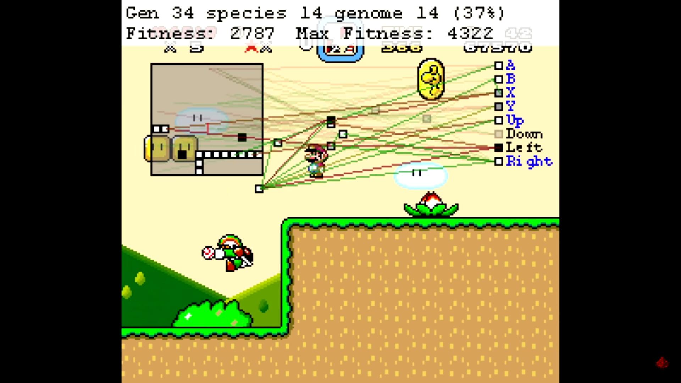
Inspiration
MarI/O - Machine Learning for Video Games by SethBling https://www.youtube.com/watch?v=qv6UVOQ0F44
Inspiration
Notes:
Sethbling’s video, posted on youtube June 2015.
What is MarI/O?
Describe Action Space here when talking about outputs

Slide 8
Start, Late 2019
“If you want to learn something, submit a talk on it.”
Start
Inspiration
Late 2019
Notes:
Late 2019, the talk wrote itself: here’s my journey, how I did it. Failure is important to share

Slide 9
Getting Started
I already knew about some forms of machine learning
Supervised
Give the computer a bunch of pictures of cats, labelled as cats, and then it will be able to recognize cats
Unsupervised
Give the computer an environment, let it take an action, and then give it a cookie if it did what you want
This is the basis of Reinforcement Learning
Start
Inspiration
Late 2019
Notes:
Tetris example?

Slide 10
But what do I need?
Emulator to play the game
Bizhawk
Allows for scripting
ROM of Super Mario Bros.
Legality?
SethBling’s code
Start
Inspiration
Late 2019
Notes:
I own a copy, not distributing the ROM

Slide 11
OVERWHELMED
Lua, a language I don’t know
I don’t know really anything about implementing the algorithms
~1200 lines of code
Start
Inspiration
Late 2019

Slide 12
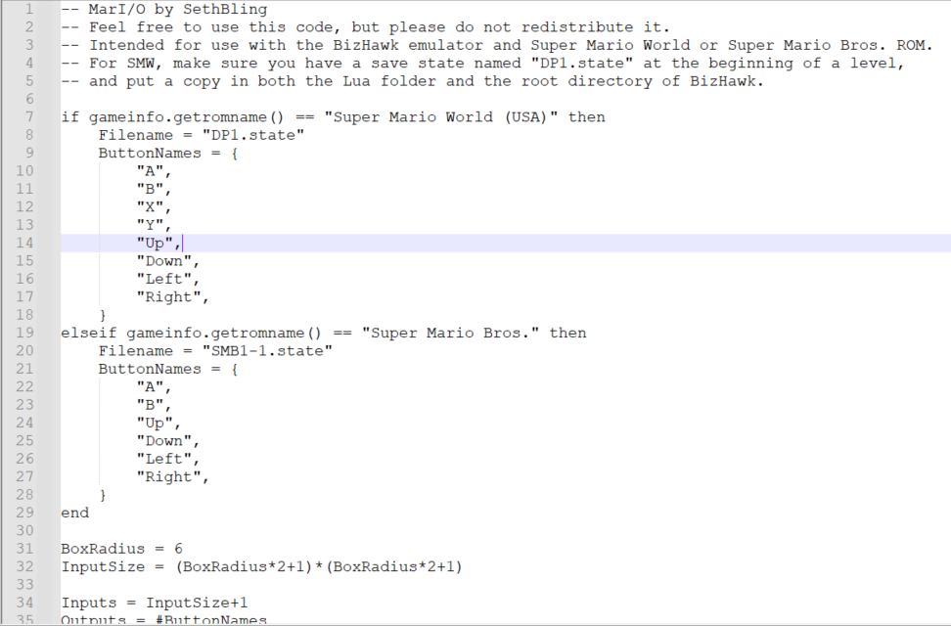

Slide 13
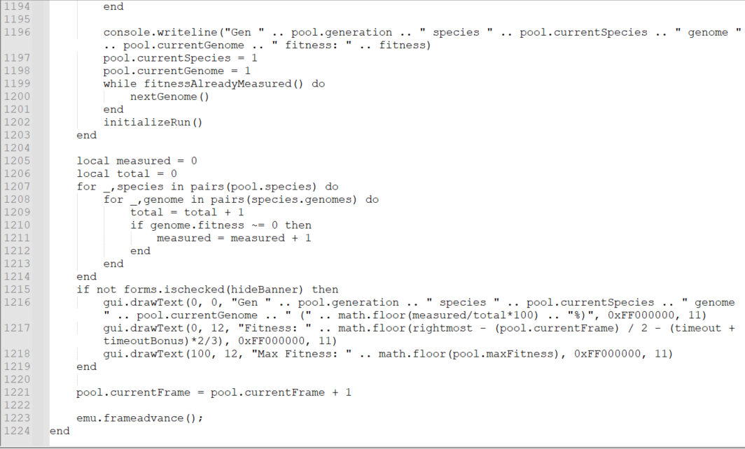

Slide 14
Recovery
SethBling’s code gets me started
I know Python, kinda
Python and Lua are both scripting languages, can Bizhawk support it?
I had access to Pluralsight
Start
Inspiration
Late 2019

Slide 15
Human Learning
How Machine Learning Works by Paolo Perrotta (course now retired)
A code-first approach to machine learning
Start
Learning
Inspiration
Late 2019
Notes:
Retired means it is still available, it just isn’t being updated any more. Canbe foun on Resources

Slide 16
Human Learning
Understanding Algorithms for Reinforcement Learning by Janani Ravi
Introductions to Open AI Gym (now Gymnasium)
Discusses Q-Learning and SARSA
Introduction to Jupyter Notebooks and Miniconda
Start
Learning
Inspiration
Late 2019
Notes:
Miniconda can swap where it works just by typing the directory you want
Q-Learning and SARSA are ways to implement RL algorithms

Slide 17
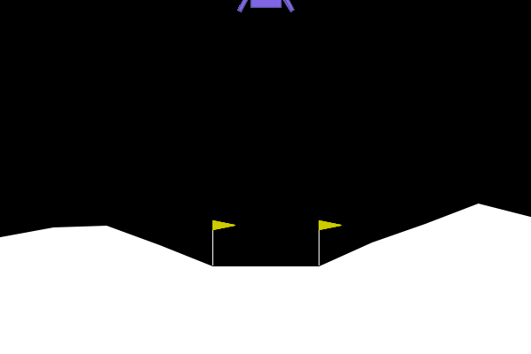
Now I am playing with power
Trying the Lunar Lander
Start
Learning
Inspiration
Late 2019
Notes:
Environment changes each time, similar to mario, this is a good place to attempt testing what I have learned

Slide 18
Struggling
New packages to install for Lunar Lander
Box2d needs Swig which needs a new channel
Adding channels to conda
Wheel Errors
Why do I need C++ compilers for Python?
Lunar Lander is hard
Tutorials
Start
Learning
Inspiration
Late 2019
Notes:
Why need C++? Python extension modules or other libraries that aren’t written in Python, C++ is a super common language for these modules
Wheels are zip files with everything you need to install a package. If you don’t have a wheel, they will be built for you.

Slide 19
Back to the drawing board
Re-look at SethBling’s code
Things make more sense now!
However, he is actually building a neural network and that still seems over my head
Start
Learning
Inspiration
Late 2019

Slide 20
Back to BizHawk
Probably wont work with Python the way it does with LUA
What emulators work with Python?
To Google!
Start
Learning
Inspiration
Late 2019

Slide 21
Gym Retro
Already has environments built for lots of classic video games
Supports .nes files – a ROM for the NES
Just install the package!
Start
Learning
Inspiration
Late 2019

Slide 22
To the code!
Testing Mario
Something works!
Start
Learning
Inspiration
Late 2019

Slide 23
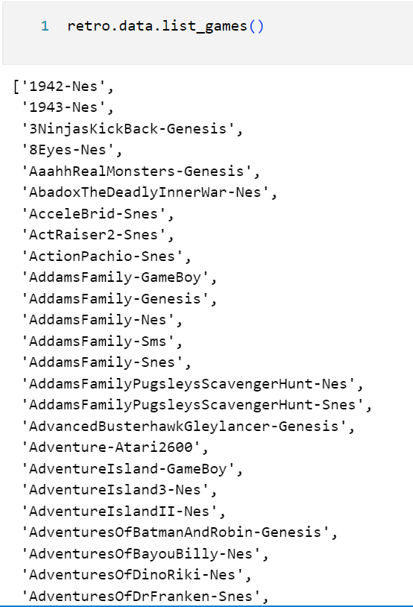
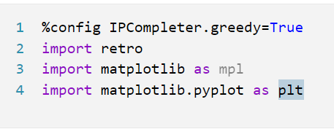

Slide 24
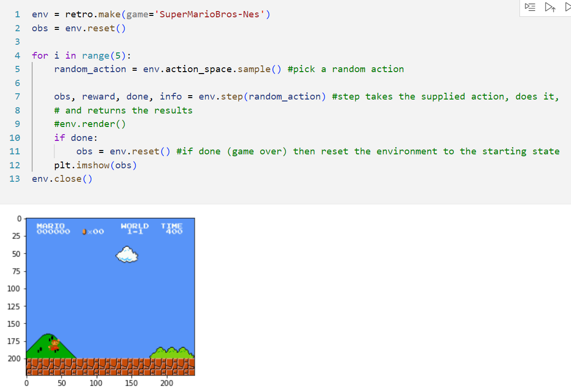

Slide 25
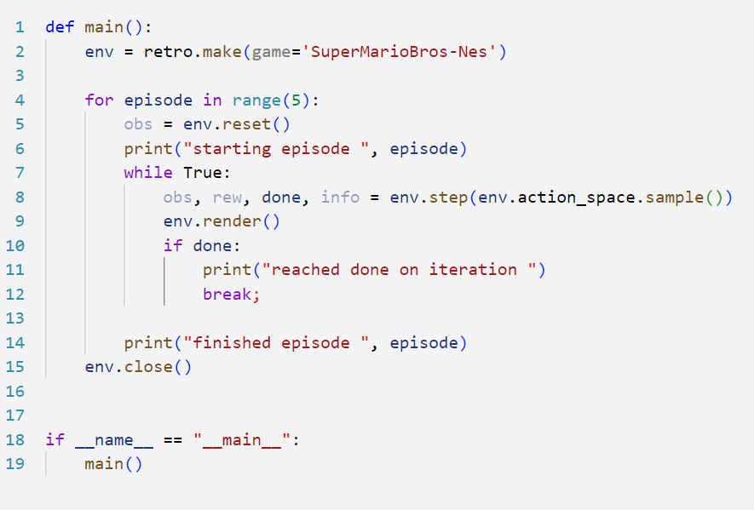

Slide 26
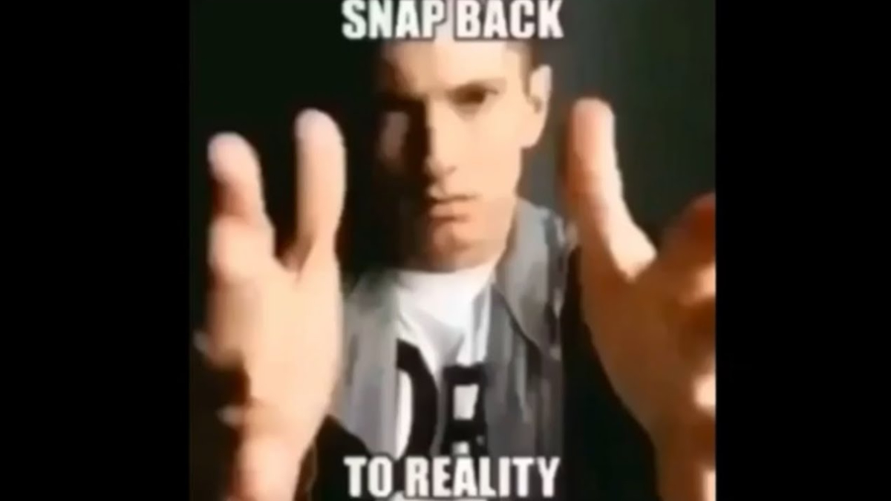

Slide 27
March 2020
Got an opportunity to work at a company that is doing AI and Machine Learning!
But it’s in QA
And everyone is using Java
And I have to use a Mac
Windows kid, sorry, not sorry
Start
Learning
New Job
Inspiration
Late 2019

Slide 28
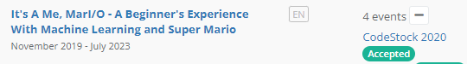
But!
I am making progress
My talk is accepted to CodeStock 2020!
Start
Learning
New Job
Inspiration
Late 2019

Slide 29
Pause #1
Pandemic and New Job
Depression
Start
Learning
New Job
Pause #1
Inspiration
Late 2019
March 2020
Notes:
This job was hard, I was bad at it, and I missed seeing people
I learned a lot about myself from this time but it wasn’t until later that I realized it

Slide 30
CodeStock 2022
Brought me out of the slump
Got me excited for tech again
Got to hang out with so many people!
Start
Learning
New Job
Pause #1
Starting Again
Inspiration
Late 2019
March 2020
Spring 2022

Slide 31
Things have changed
New computer
Python and Jupyter Notebooks are easily run through VSCode
Start
Learning
New Job
Pause #1
Starting Again
Inspiration
Late 2019
March 2020
Spring 2022

Slide 32
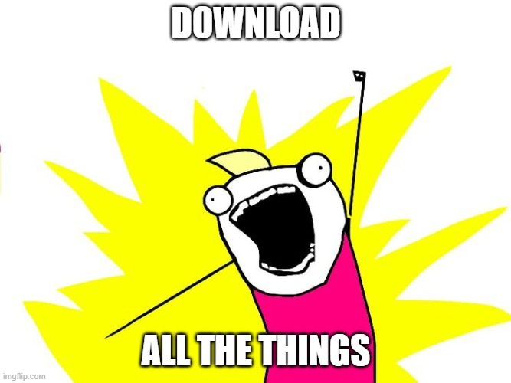

Slide 33
C++? But I am using Python!
Unknown Compiler Error
Install C++ Compiler in VS Code
Ran Hello World and it works
No dice…
Start
Learning
New Job
Pause #1
Starting Again
Inspiration
Late 2019
March 2020
Spring 2022
Notes:
This had worked on my previous computer because I ha already installed Visual Studio for other development reasons. That’s why I am getting the errors now

Slide 34
Curses, versioned again
Misleading error about C++ compilation
Gym-retro only supports Python 3.8
VS Code, rightfully installed the latest Python version
Downgrading to 3.8 from current fixed everything
Start
Learning
New Job
Pause #1
Starting Again
Inspiration
Late 2019
March 2020
Spring 2022

Slide 35
More problems
Reimport the ROM
Error, missing pygame
Install pygame
Module not found error, how to fix?
Google to the rescue, downgrade gym!
Changing gym to version 0.21.0 from 0.23.1 fixed it
https://www.reddit.com/r/reinforcementlearning/comments/uklf29/no_module_named_gymenvsclassic_controlrendering/
Start
Learning
New Job
Pause #1
Starting Again
Inspiration
Late 2019
March 2020
Spring 2022

Slide 36
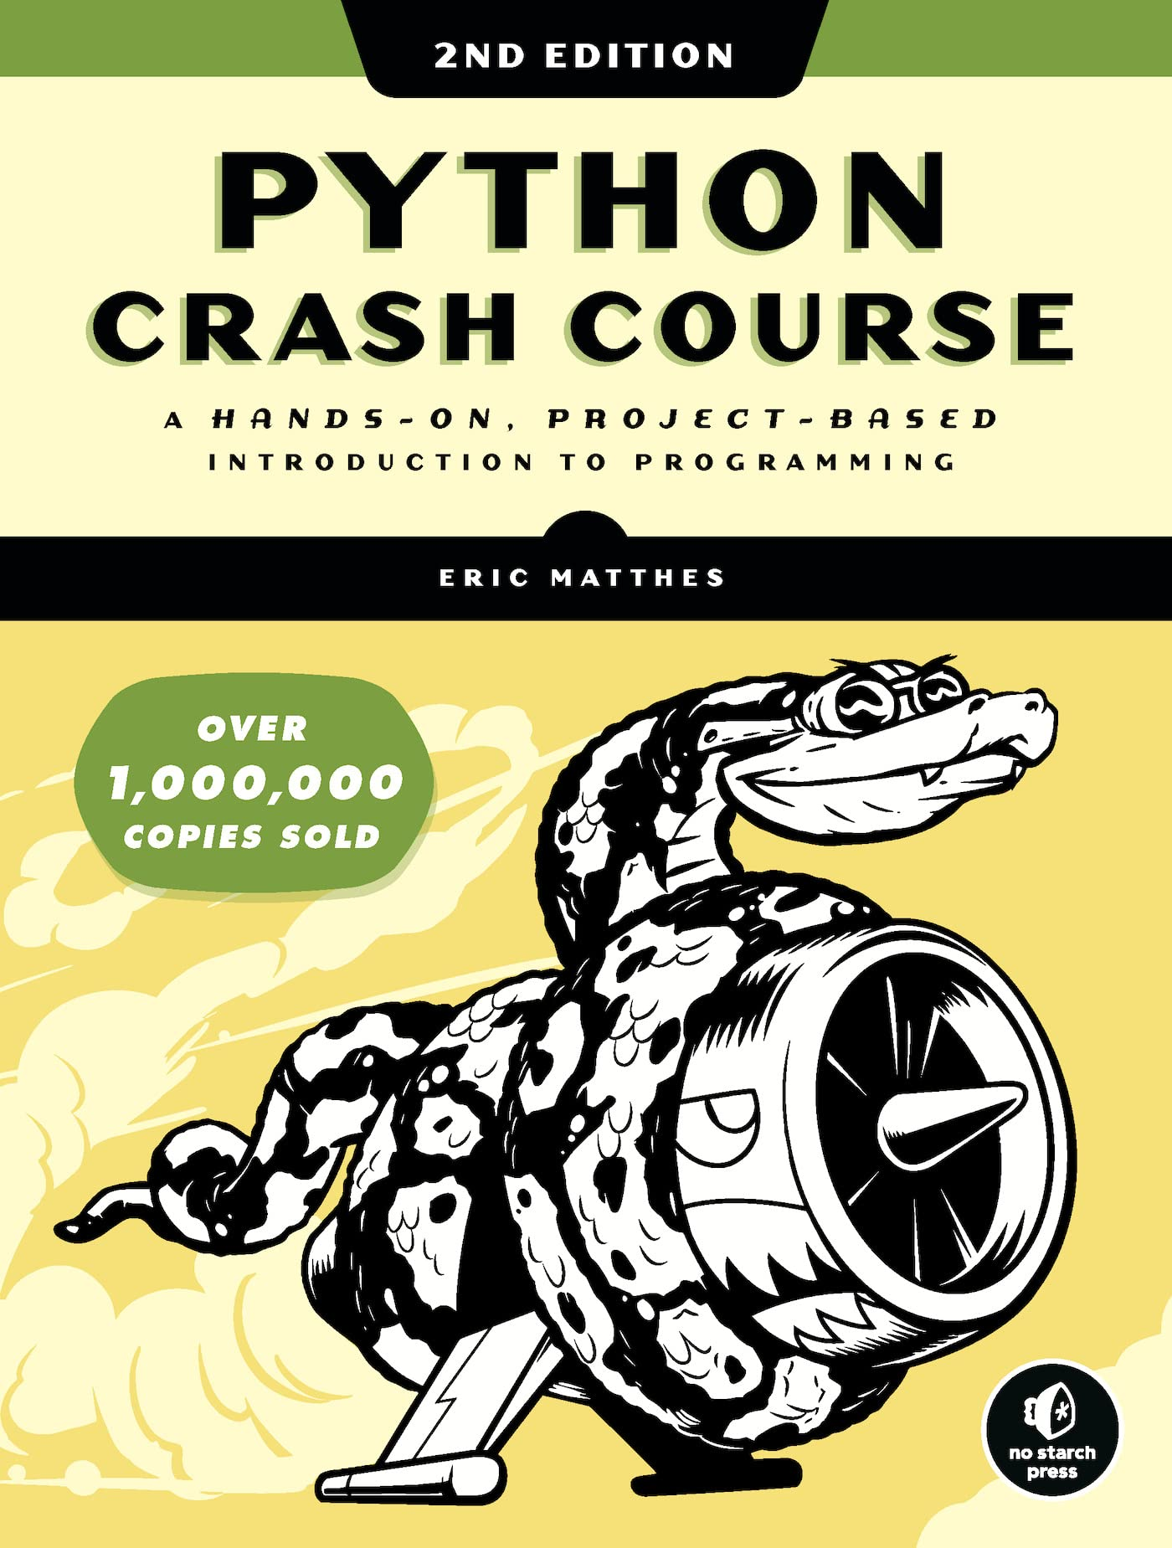
Mentorship
Talking with a co-worker about my struggles and interests, he suggested a mentor/mentee relationship
He first suggested a book
There is a 3rd edition now
Start
Learning
New Job
Pause #1
Starting Again
Inspiration
Late 2019
March 2020
Spring 2022
Notes:
I have been at my job for a little over 2 years at this point

Slide 37
Making progress again
All my code runs now!
Last iteration hangs, something isn’t right with the code
Need to figure out how to kill Mario. For good.
Start
Learning
New Job
Pause #1
Starting Again
Inspiration
Late 2019
March 2020
Spring 2022

Slide 38
More mentorship
Exporting Environments
Lets you recreate and redownload all the packages you have on a whim
Remember this for the future
Build a Mario AI Model with Python | Gaming Reinforcement Learning by Nicholas Renotte
https://www.youtube.com/watch?v=2eeYqJ0uBKE
Start
Learning
New Job
Pause #1
Starting Again
Inspiration
Late 2019
March 2020
Spring 2022
Notes:
This video was published in December of 2021

Slide 39
Self Validation
The video had comparable code to some of what I had written on my own
Nicholas Renotte’s is complete and set up as a tutorial
Follow the tutorial!
Start
Learning
New Job
Pause #1
Starting Again
Inspiration
Late 2019
March 2020
Spring 2022
Notes:
This video I not exist when I started this project

Slide 40
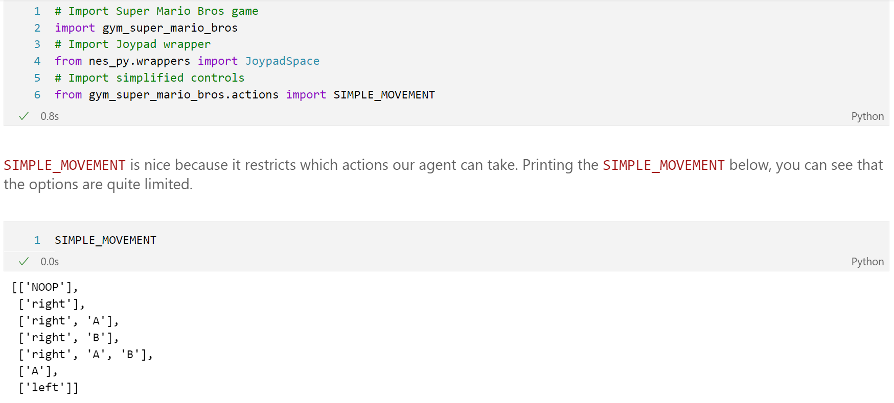

Slide 41
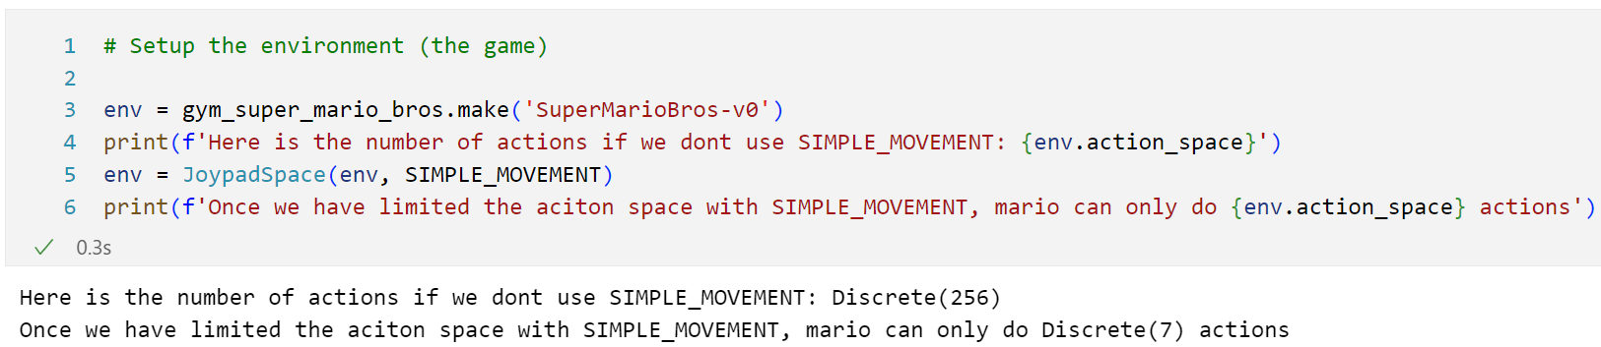

Slide 42
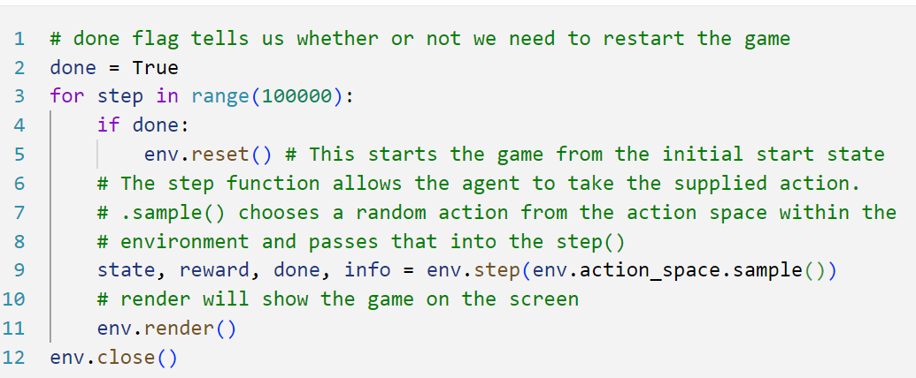

Slide 43
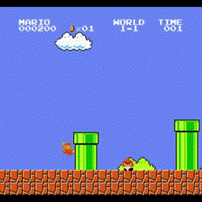

Slide 44
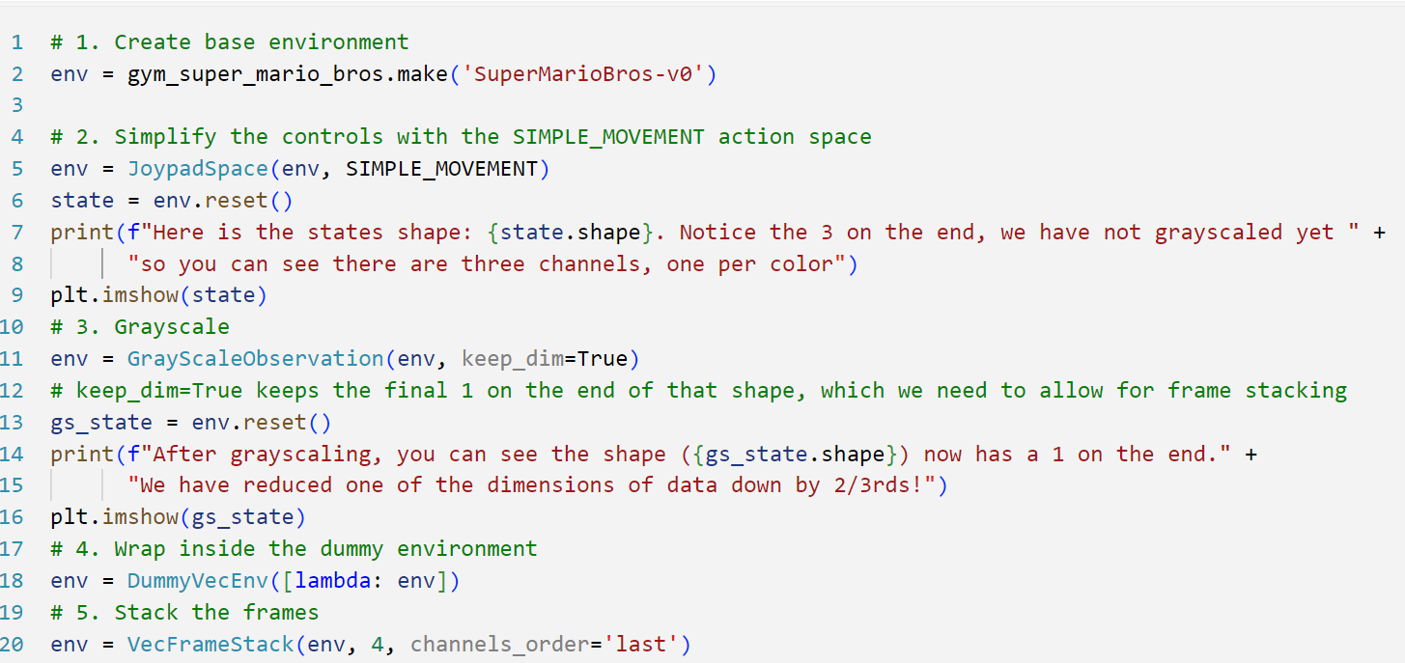

Slide 45
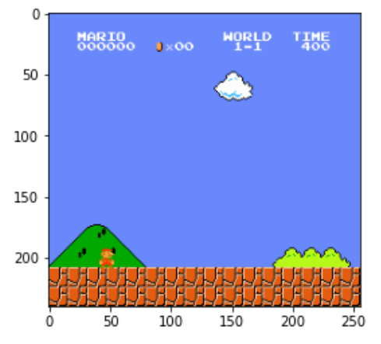
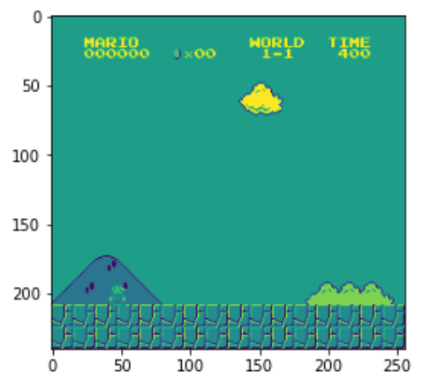
Before Grayscaling
Here is the state’s shape: (240, 256, 3). Notice the 3 on the end, we have not grayscaled yet so you can see there are three channels, one per color
After Grayscaling
After grayscaling, you can see the shape ((240, 256, 1)) now has a 1 on the end. We have reduced one of the dimensions of data down by 2/3rds!

Slide 46
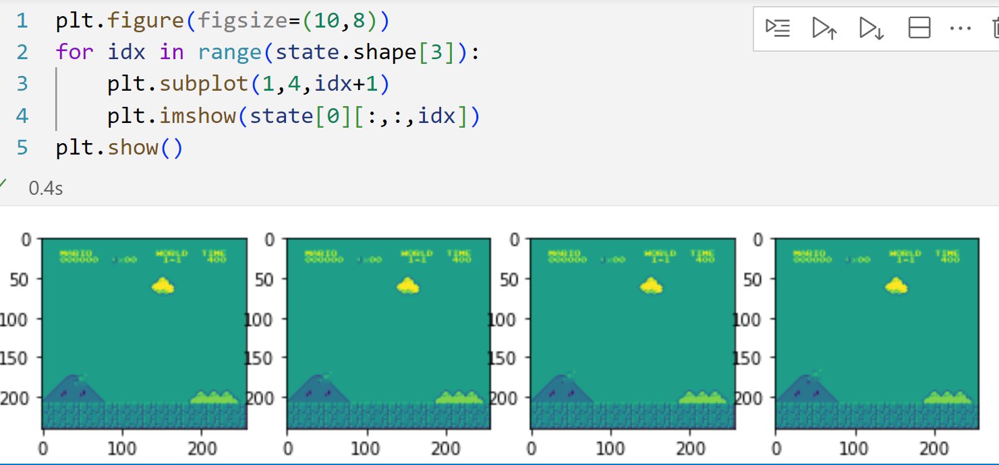

Slide 47
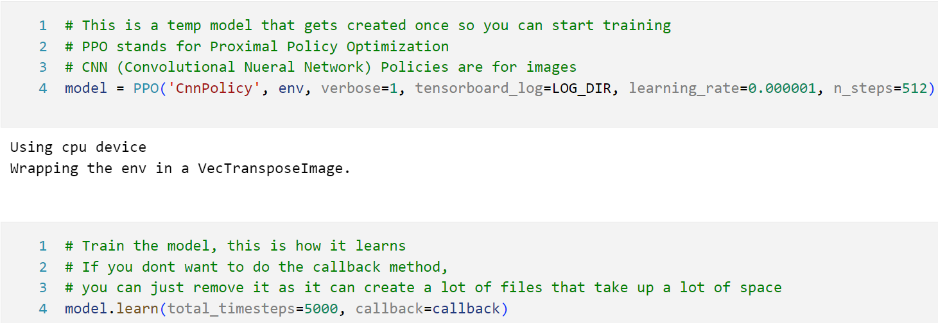
Notes:
Verbose is logging output
LOG_DIR is a local directory file path
learning_rate is important. The larger the number, the faster it will learn, but there is a higher chance it converges on a non-optimal solution. The smaller it is, the longer it takes to train to reach an optimal solution.
N_steps is how many steps in the episode will be taken for updating the model
Callback method is created above to handle saving the “best” model to your training folder

Slide 48
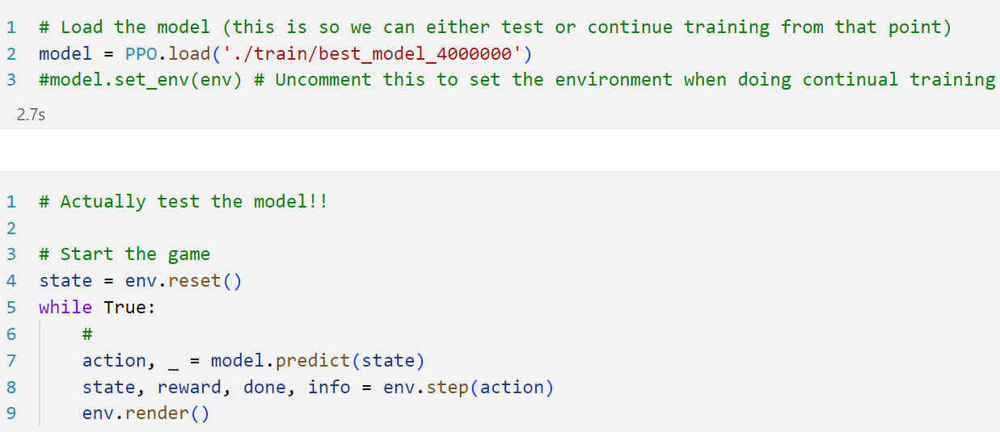

Slide 49
Problems with the tutorial
Me, it’s a me problem
Stable Baselines3,
Library of reinforcement learning algorithms
Can be set up to use CUDA for GPU processing or CPU.
I picked CPU
On a laptop
Start
Learning
New Job
Pause #1
Starting Again
Inspiration
Late 2019
March 2020
Spring 2022
Notes:
At step 3 of the tutorial, I set the training to be 100,000 steps first since I didn't know how long it was going to take on my machine. I set the log checking in the callback method to 25k (equally divisible into the step count for simplicity) so that I would end up with 4 versions of my model.
PyTorch is a library for deep learning using GPUs and CPUs

Slide 50
Forever
Tutorial showed good results of training at 4 million steps
I chose a “small” set of training iterations, 100,000 steps
It took 277 minutes, ~ 4.6 hours
Quick math: 184.6 hours, or 7.6 days, of continuous training on my laptop
Start
Learning
New Job
Pause #1
Starting Again
Inspiration
Late 2019
March 2020
Spring 2022
Notes:
My computer might just explode

Slide 51
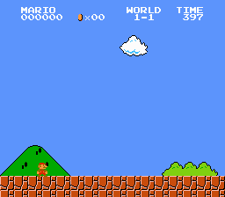
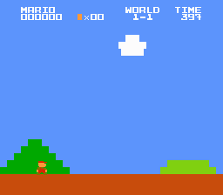
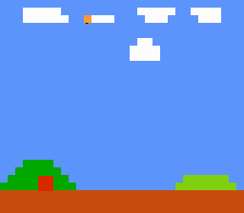
How to improve?
Retrain with the CUDA GPU version and see if that is faster
Choose a different training algorithm
The Mario environment can be simplified
Start
Learning
New Job
Pause #1
Starting Again
Inspiration
Late 2019
March 2020
Spring 2022
Notes:
This is around mi August 2022

Slide 52
Pause #2
Aug 2022, Laid off
Kick in the ego
Sep 2022, New Job
Back to development again!
Start
Learning
New Job
Pause #1
Starting Again
Pause #2
Inspiration
Late 2019
March 2020
Spring 2022
Aug 2022

Slide 53
Fast Forward…
Aug 2023
This talk/project has been in the works for ~4 years now
Maybe I should finish it?
Submit to DevMoot!
Start
Learning
New Job
Pause #1
Starting Again
Pause #2
Submit Talk
Inspiration
Late 2019
March 2020
Spring 2022
Aug 2022
Aug 2023
Notes:
I have been doing better, back at least in something I feel comfortable in which helps me to rebuild the ego stomping I took at my previous job.

Slide 54
Accepted
Yay?
Start
Learning
New Job
Pause #1
Starting Again
Pause #2
Submit Talk
Inspiration
Late 2019
March 2020
Spring 2022
Aug 2022
Aug 2023

Slide 56
Thanks, past me
The notes I had taken for this talk helped
Clear path on redownloading all the libraries and apps I need
Start
Learning
New Job
Pause #1
Starting Again
Pause #2
Submit Talk
Inspiration
Late 2019
March 2020
Spring 2022
Aug 2022
Aug 2023

Slide 57
Problems again?!
Why is Open AI Gym a problem?
It’s been updated to Gymnasium
What other updates have happened in the last year?
Gym is on 0.26 now, so maybe that rendering issue from 0.23.0 is gone?
Start
Learning
New Job
Pause #1
Starting Again
Pause #2
Submit Talk
Inspiration
Late 2019
March 2020
Spring 2022
Aug 2022
Aug 2023

Slide 58
The problems don’t stop
Pull down my Mario repo
Trying to recreate the environment manually
Mostly works
The .step() function now returns more arguments
Start
Learning
New Job
Pause #1
Starting Again
Pause #2
Submit Talk
Inspiration
Late 2019
March 2020
Spring 2022
Aug 2022
Aug 2023

Slide 59
Thanks, past me. Again.
Environments can be recreated from yml files, I have one of those!
Export the working environment from my old laptop and recreate it on the new computer
Warning! Removing an environment doesn’t uninstall the downloaded libraries so collisions can happen!
Start
Learning
New Job
Pause #1
Starting Again
Pause #2
Submit Talk
Inspiration
Late 2019
March 2020
Spring 2022
Aug 2022
Aug 2023
Notes:
REMEMBER WHAT I SAID ABOUT ENVIRONMENT FILES?
I spent several days trying to get everything to work so I could set up the training

Slide 60
Environment ready
End up with 2 environments
marioEnv (original)
marioEnv-V2 (updated)
V2 broke matplotlib?
Fortunately not needed to train the model so I chose to ignore it.
The moment of truth…
Start
Learning
New Job
Pause #1
Starting Again
Pause #2
Submit Talk
Inspiration
Late 2019
March 2020
Spring 2022
Aug 2022
Aug 2023

Slide 61


Slide 62
Time to train
Simple test: time 100 iterations
2 seconds
1,000 iterations
~62 seconds
10,000 iterations?
9 minutes, 59 second
Start
Learning
New Job
Pause #1
Starting Again
Pause #2
Submit Talk
Inspiration
Late 2019
March 2020
Spring 2022
Aug 2022
Aug 2023

Slide 63
New Record!
Target is 4 Million iterations
4M should take around 4000 minutes
66 hours!
Huge improvement of the almost 7 days on the laptop!
Start
Learning
New Job
Pause #1
Starting Again
Pause #2
Submit Talk
Inspiration
Training
Late 2019
March 2020
Spring 2022
Aug 2022
Aug 2023

Slide 64
Batch training
Can’t run for 66 hours straight
How to train in batches?
model.set_env(env)
Update callback method to use starting point
Start
Learning
New Job
Pause #1
Starting Again
Pause #2
Submit Talk
Inspiration
Training
Late 2019
March 2020
Spring 2022
Aug 2022
Aug 2023
Notes:
Show code again and speak a bit more in depth about what I did there

Slide 65
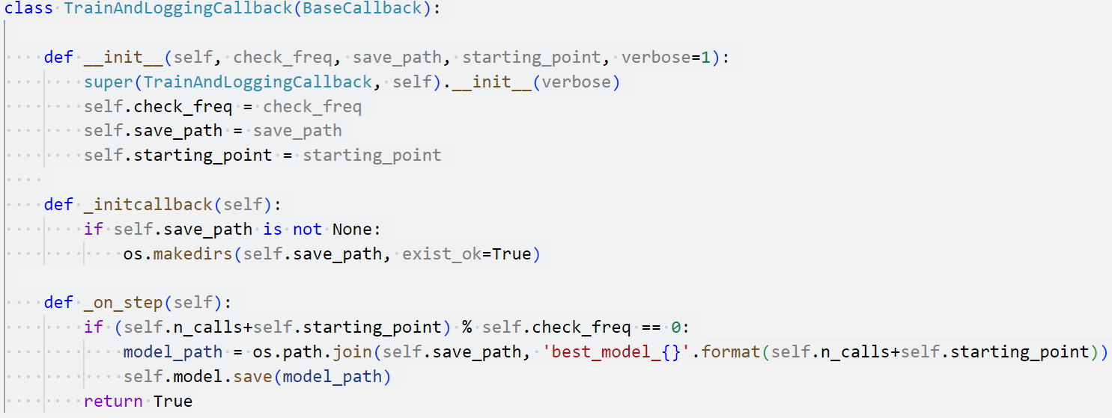

Slide 66
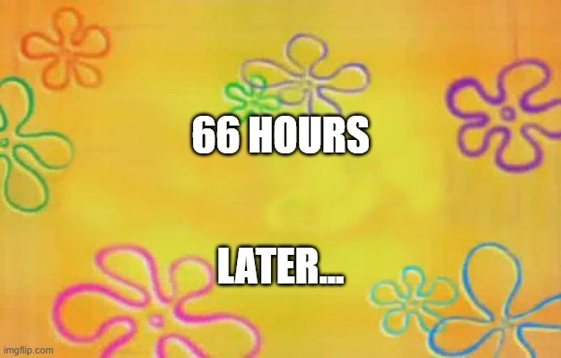

Slide 67
Go Mario, Go!
Start
Learning
New Job
Pause #1
Starting Again
Pause #2
Submit Talk
Done!
Inspiration
Training
Late 2019
March 2020
Spring 2022
Aug 2022
Aug 2023

Slide 68
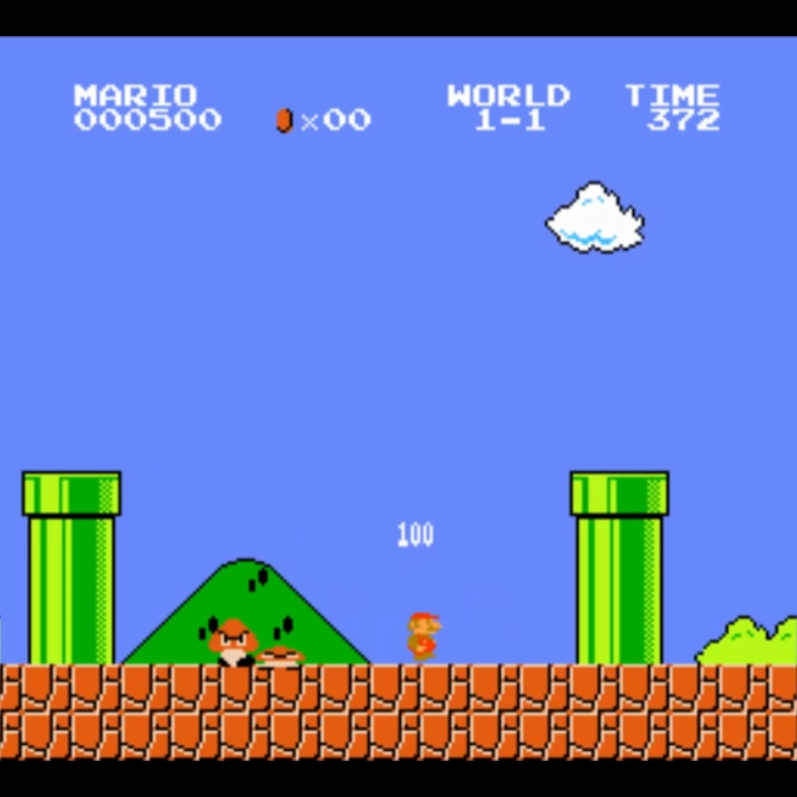

Slide 69
Takeaways
Get someone else to do if for you
JOKING! Tutorials are helpful, but don’t rely on them to teach you everything
Find a mentor/teacher/accountabilibuddy
Take it a bit at a time
Start
Learning
New Job
Pause #1
Starting Again
Pause #2
Submit Talk
Done!
Inspiration
Training
Late 2019
March 2020
Spring 2022
Aug 2022
Aug 2023

Slide 70
Takeaways
Throw more power at the problem
Take notes
Never update anything
JOKING! Versioning is important, pay attention
Success and progress is a journey and self motivation can be difficult
Start
Learning
New Job
Pause #1
Starting Again
Pause #2
Submit Talk
Done!
Inspiration
Training
Late 2019
March 2020
Spring 2022
Aug 2022
Aug 2023

Slide 72
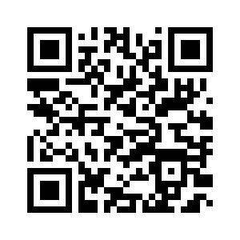
https://github.com/gex713/mario-ml
@HueyTheDM
Linkedin.com/in/houston-miller

Slide 73
Resources
Pluralsight course - How Machine Learning Works by Paolo Perotta (Retired): https://app.pluralsight.com/library/courses/how-machine-learning-works/table-of-contents
Pluralsight course - Understanding Algorithms for Reinforcement Learning by Janani Ravi: https://app.pluralsight.com/library/courses/understanding-algorithms-reinforcement-learning/table-of-contents
OpenAIGym: https://gym.openai.com/
Conda: https://docs.conda.io/projects/conda/en/latest/index.html
https://towardsdatascience.com/solving-lunar-lander-openaigym-reinforcement-learning-785675066197
Deep Q Learning for Video Games - The Math of Intelligence #9: https://youtu.be/79pmNdyxEGo
Q Learning Explained: https://www.youtube.com/watch?v=aCEvtRtNO-M
Lunar Lander:
https://github.com/gabrielgarza/openai-gym-policy-gradient
https://medium.com/@gabogarza/deep-reinforcement-learning-policy-gradients-8f6df70404e6
pip/conda install issues with building wheel: https://github.com/openai/spinningup/issues/32
What are Python Wheels: https://realpython.com/python-wheels/
https://towardsdatascience.com/reinforcement-learning-from-scratch-designing-and-solving-a-task-all-within-a-python-notebook-48c40021da4
Build a Mario AI Model with Python | Gaming Reinforcement Learning by Nicholas Renotte: https://www.youtube.com/watch?v=2eeYqJ0uBKE
Retro Gym: https://github.com/openai/retro
getting started docs: https://retro.readthedocs.io/en/latest/getting_started.html
Add jupyter notebooks to VSCode: https://code.visualstudio.com/docs/datascience/jupyter-notebooks
Super Mario Bros gym: https://pypi.org/project/gym-super-mario-bros/0.4.0/
py-torch: https://pytorch.org/get-started/locally/
stable-baselines3: https://stable-baselines3.readthedocs.io/en/master/guide/install.html
continual learning: https://github.com/hill-a/stable-baselines/issues/599
stable-baselines3 continual learning: https://stable-baselines.readthedocs.io/en/master/guide/examples.html#continual-learning
Gymnasium: https://gymnasium.farama.org/

Slide 74
Thank You
Join us on the KnoxDevs slack for more events!

